Slide 1
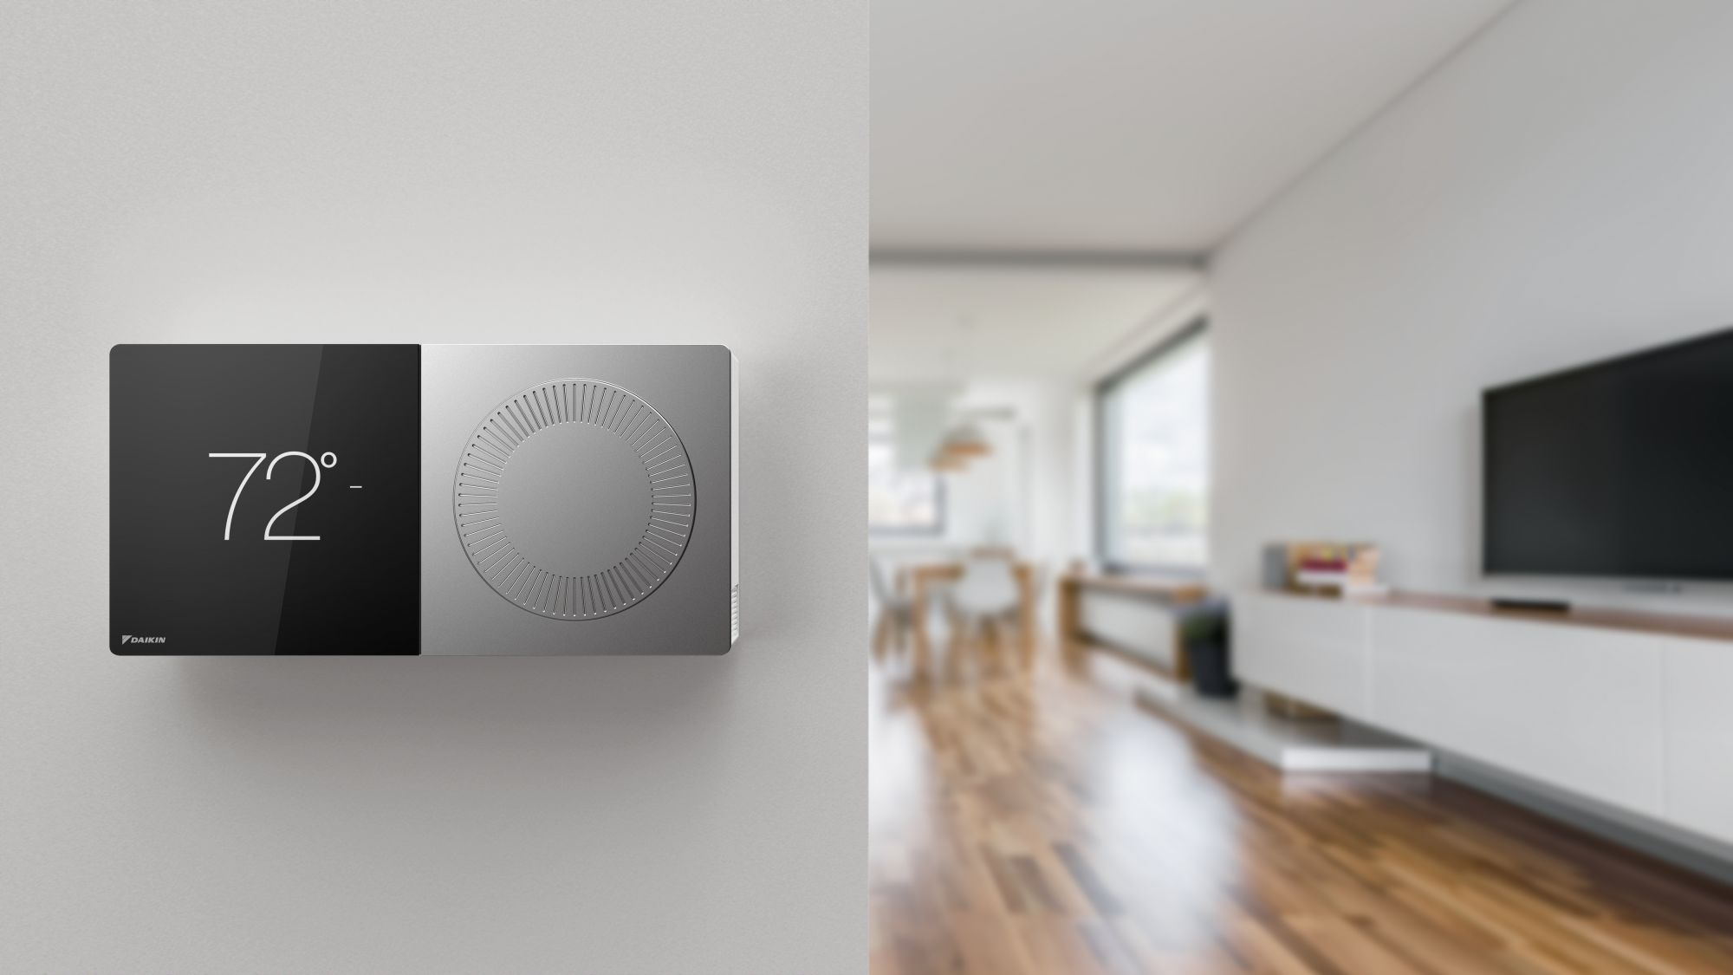

SMART HOME SERVICES
K-VALUE
FOCUS ON THE WHY

Slide 2
INDEX
1.ABOUT US
2.WHAT WE DO!
3.SOLUTIONS
4.PROPOSAL
5.CONTACT
Pages 03 - 06
Pages 07 - 10
Pages 11 - 16
Pages 17 - 23
Pages 24 - 25

Slide 3

1.
ABOUT US

Slide 4

About us
Oriented on a ‘client’s first’ philosophy we are always focus to bring the best service.
We are specialists in business solutions and we work for all kind of companies, from little family businesses to big international companies.

Slide 5

A little bit
of history
K-Value was established in Barcelona, in October of 2018.
Was founded by Kiko Sánchez after 10 years working as ‘Data analyst’ for an important data advisory firm.
6 months later, the team has grown into 3 employees and more than 10 external collaborators.

Slide 6
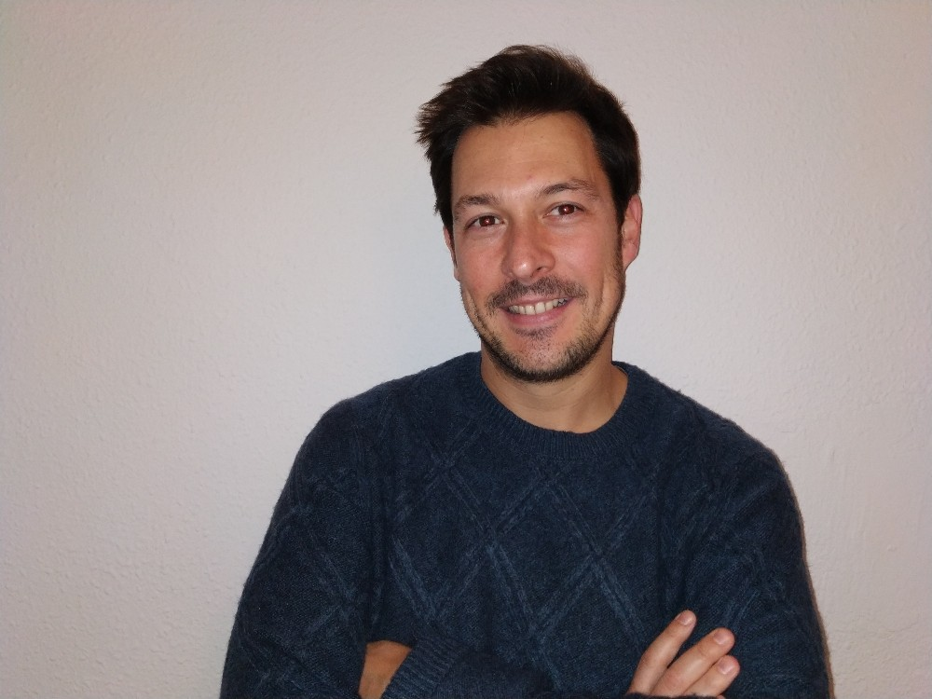


Meet our Team
KIKO SÁNCHEZ
KATHY NARIM-NOMSTROM
TOM TOMS
FOUNDER
IOT ANALYTICS
SALES MANAGER
If you’re not having fun with what
you’re doing then you’re doing it wrong.
If you are working on something that you really care about, you don’t have to be pushed. The vision pulls you.
The way get started is to quit talking and begin doing.

Slide 7

2.
WHAT WE DO

Slide 8
What we do?
DATA COLLECTION
DATA CLEANING &
PRE-PROCESSING
DATA ANALYSIS &
MACHINE LEARNING
REPORT & OPTIMIZE
1
2
3
4

Slide 9
01. PRE - PROCESS
Collect, clean and adapt the data to our main goals.
04. OPTIMIZE
02. ANALYZE
Suggestions for the future and improvements to get a better performance.
Searching for patterns and plot interesting results.
03. REPORTING
Getting conclusions for writing a report of the goals.

Slide 10



Some of our clients
We are proud to work for…

Slide 11

3.
SMART HOME
SOLUTIONS

Slide 12
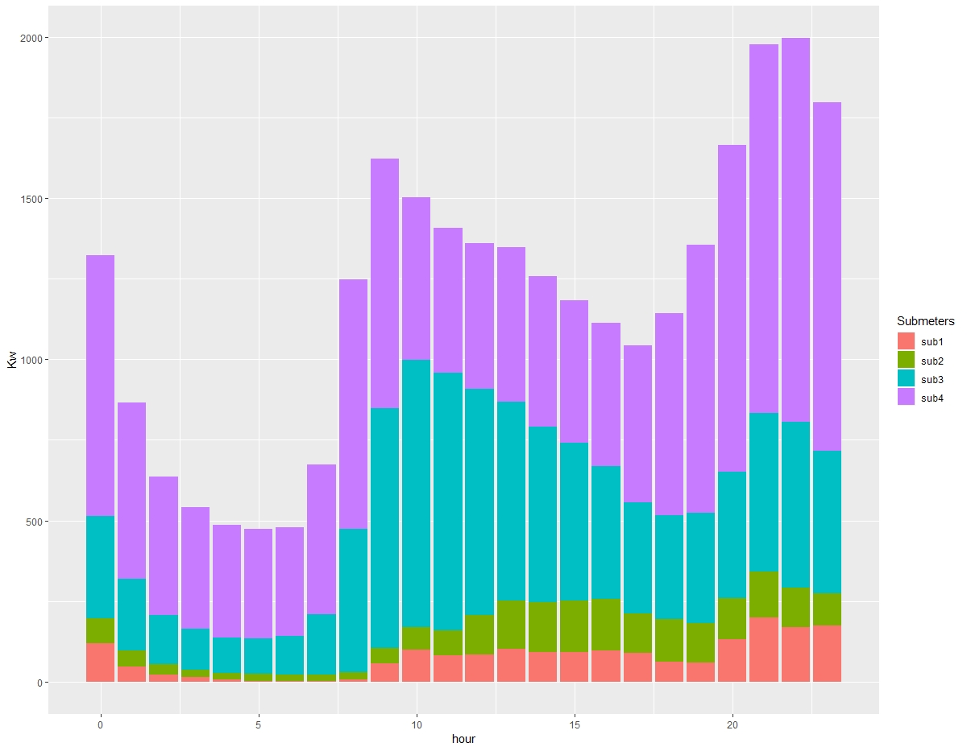
Analysis
We will provide all kind of consumption analysis. We will analyze the energy used by hours, days, weeks, months, years or even by each sub-meter that we’ll install.
Kitchen
Laundry room
Hater-water & Air-cond.
Energy not submeterd

Slide 13
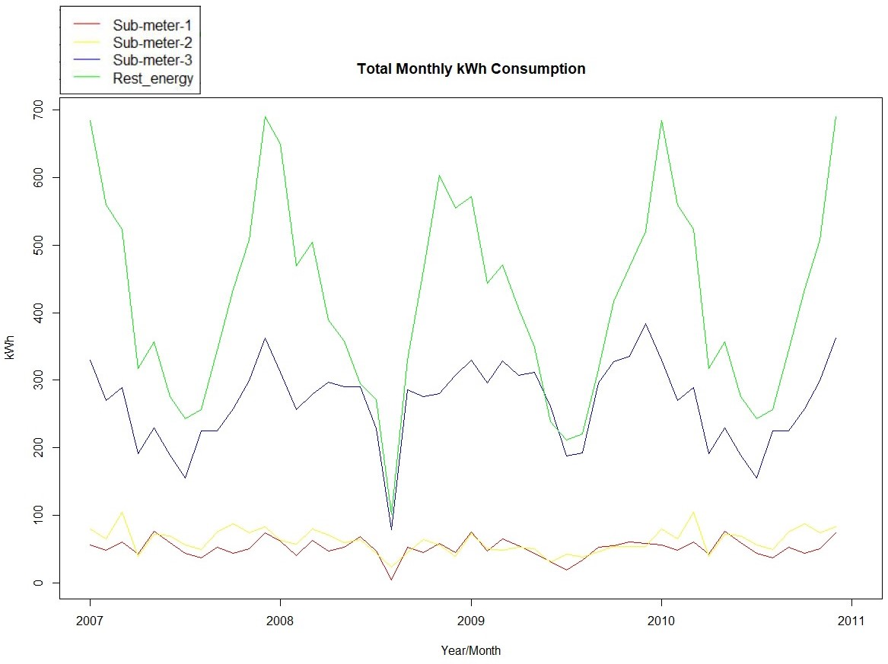
Forecasts
We will be able to build forecast models, based on the data, to predict future consumptions.

Slide 14
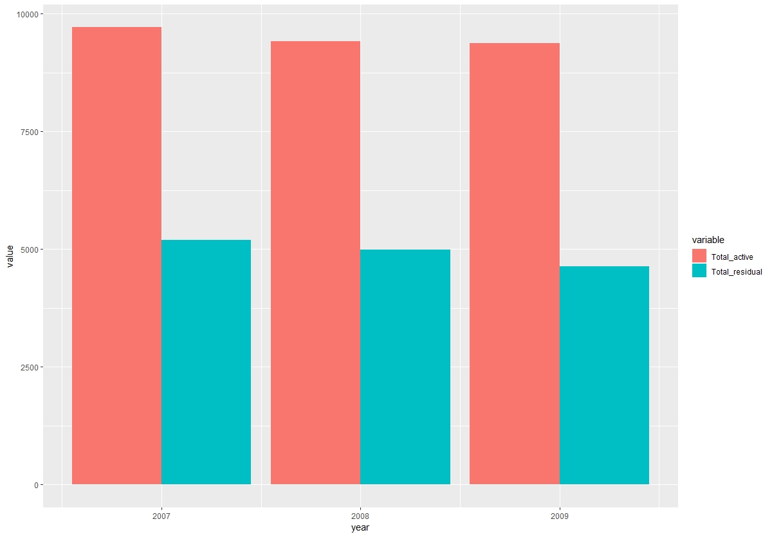
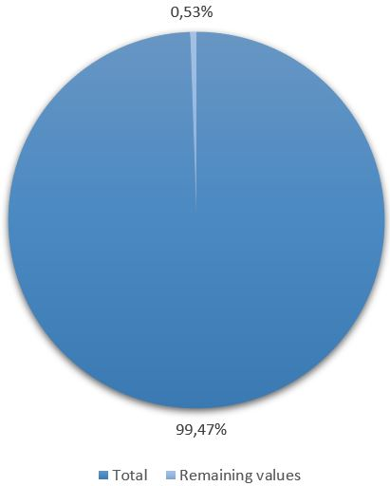
Detect anomalies
As we saw in the previous graphs, we have detected than more than 50% of the energy is not sub-metered, right now.
Also, we detected missing data over the years. We will offer solutions to fix that.

Slide 15

Performance solutions
A continous measuring of the energy will give us the opportunity to suggest better grouping combinations in order to have a good energy performance in the house.
Also, we can give eco-friendly suggestions for those families interested for the environment respect.

Slide 16
ADVANTAGES
FOR YOU
FOR YOUR CLIENTS
OFFER SOMETHING DIFERENT
CONTROL THEIR ENERGY CONSUMPTION
LOW INVESTMENT
SAVE MONEY ON THEIR ENERGY BILLS
ADD ANOTHER SOURCE OF REVENUE
DETECT UNUSUAL PERFORMANCE OF THEIR ELECTRIC DEVICES
ECO-FRIENDLY BUILDING SOLUTION
MAKE THEIR LIFE EASIER

Slide 17

4.
PROPOSAL

Slide 18
Consumption
ENERGY
DASHBOARD
Forecast
Payments history
70%
Notifications
Weather
Actual consumption
Settings
(comparing last month)
Update firmware
Home automation

Slide 19
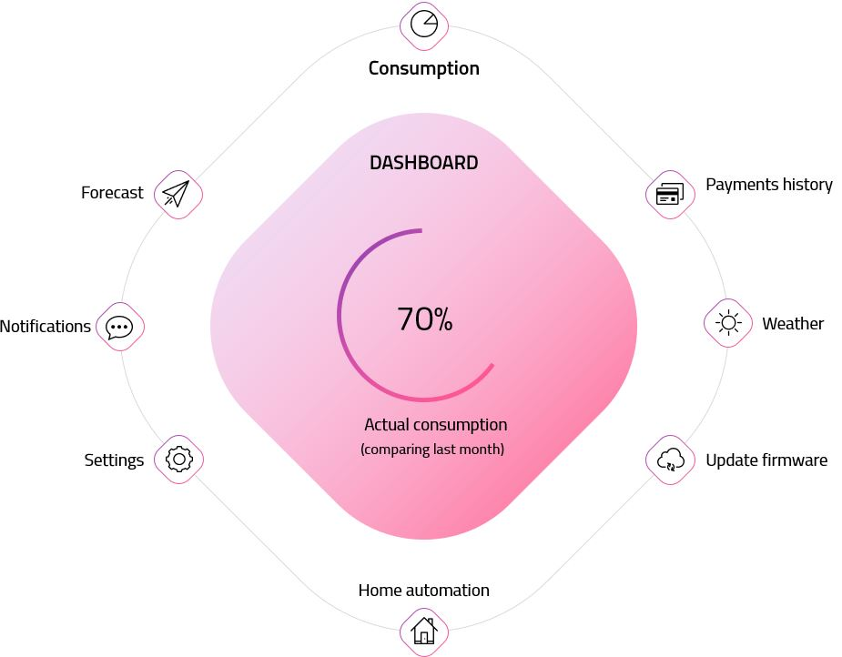

Slide 20

PROJECT
IMPLEMENTATION
(Agenda)
25th
April
Defining the project
We will define the project, the main goals and needs. (2 DAYS)

Slide 21

Pre-process data
29th
April
We will clean, pre-process and analyse all the data. (4 DAYS)
Modelling
3rd
May
We will create the optimal model to assess best forecasts (2 DAYS).
Build the dashboard
7th
May
We will create a first version of the client’s dashboard (2 DAYS).

Slide 22
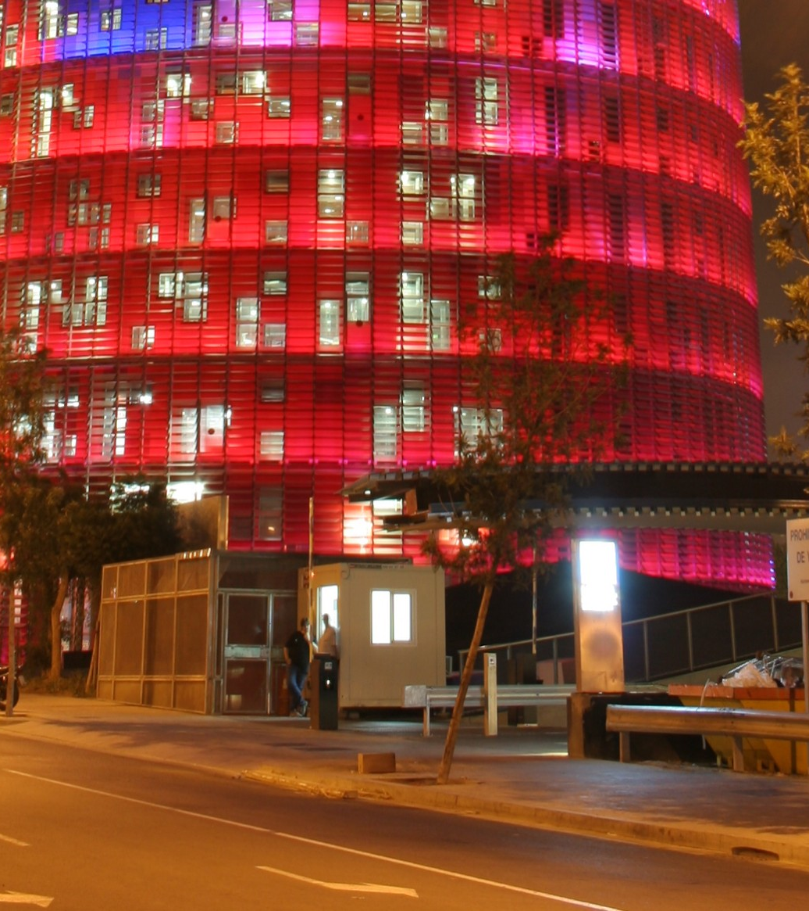
9th
May
Project presentation & 1st Dashboard delivery
Delivery an initial version of the client’s dashboard and presentation of the project.
1
month
Update
Maintenance
Firmware updates
Model improvement
New suggestions
Monthly report

Slide 23
Basic
Pro
Ultimate
Initial fee (setup & 1st Dashboard) | 300$ | 480$ | 600$
Monthly Fee | 50$ | 80$ | 100$
Users | 1 | 2 | 5
Payments history | Included | Included | Included
Weather | Included | Included | Included
Cloud service | Not included | Included | Included
Smart notifications | Not included | Included | Included
Forecasting | Not included | Not included | Included

Slide 24

5.
CONTACT

Slide 25
01
HEADQUARTERS
Av. Diagonal 597, 5th floor
08012 Barcelona, Spain
Phone: 934572282
WE ARE HERE
Glad to hearing
from you
02
E-MAIL ADDRESSES
Infor: info@kvalue.com
Sales: sales@kvalue.com
Support: support@kvalue.com
03
SOCIAL MEDIA

